Slide 1
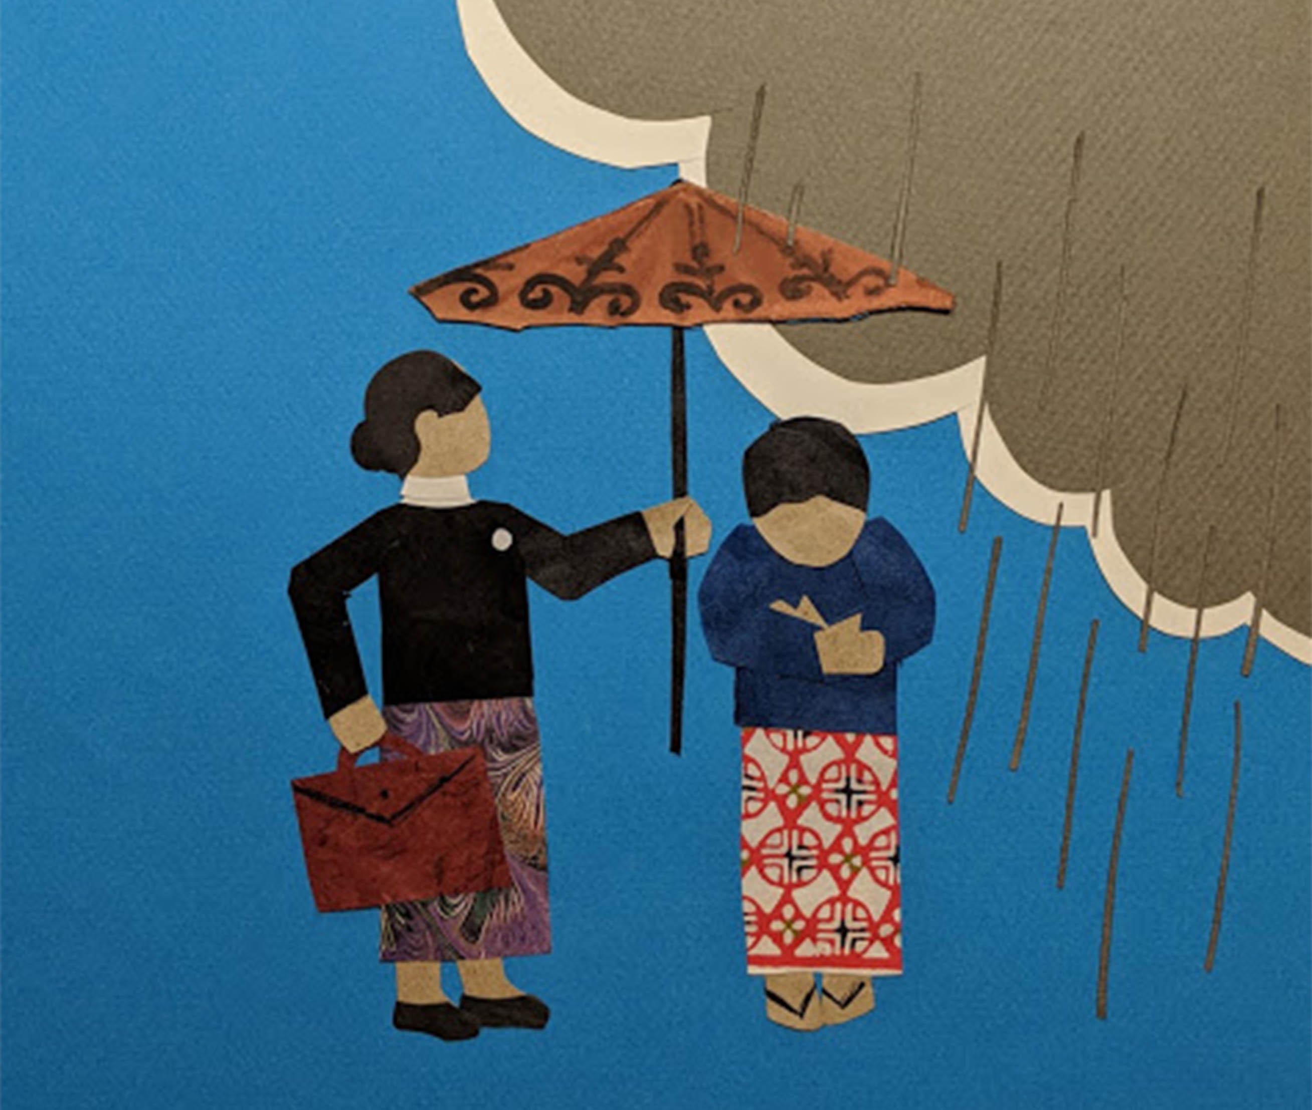
IBJ’s Human Rights Protection and Access to Justice Work in Myanmar
A Brief Introduction
Kyi Suu
Country Program Manager
IBJ Myanmar

Slide 2
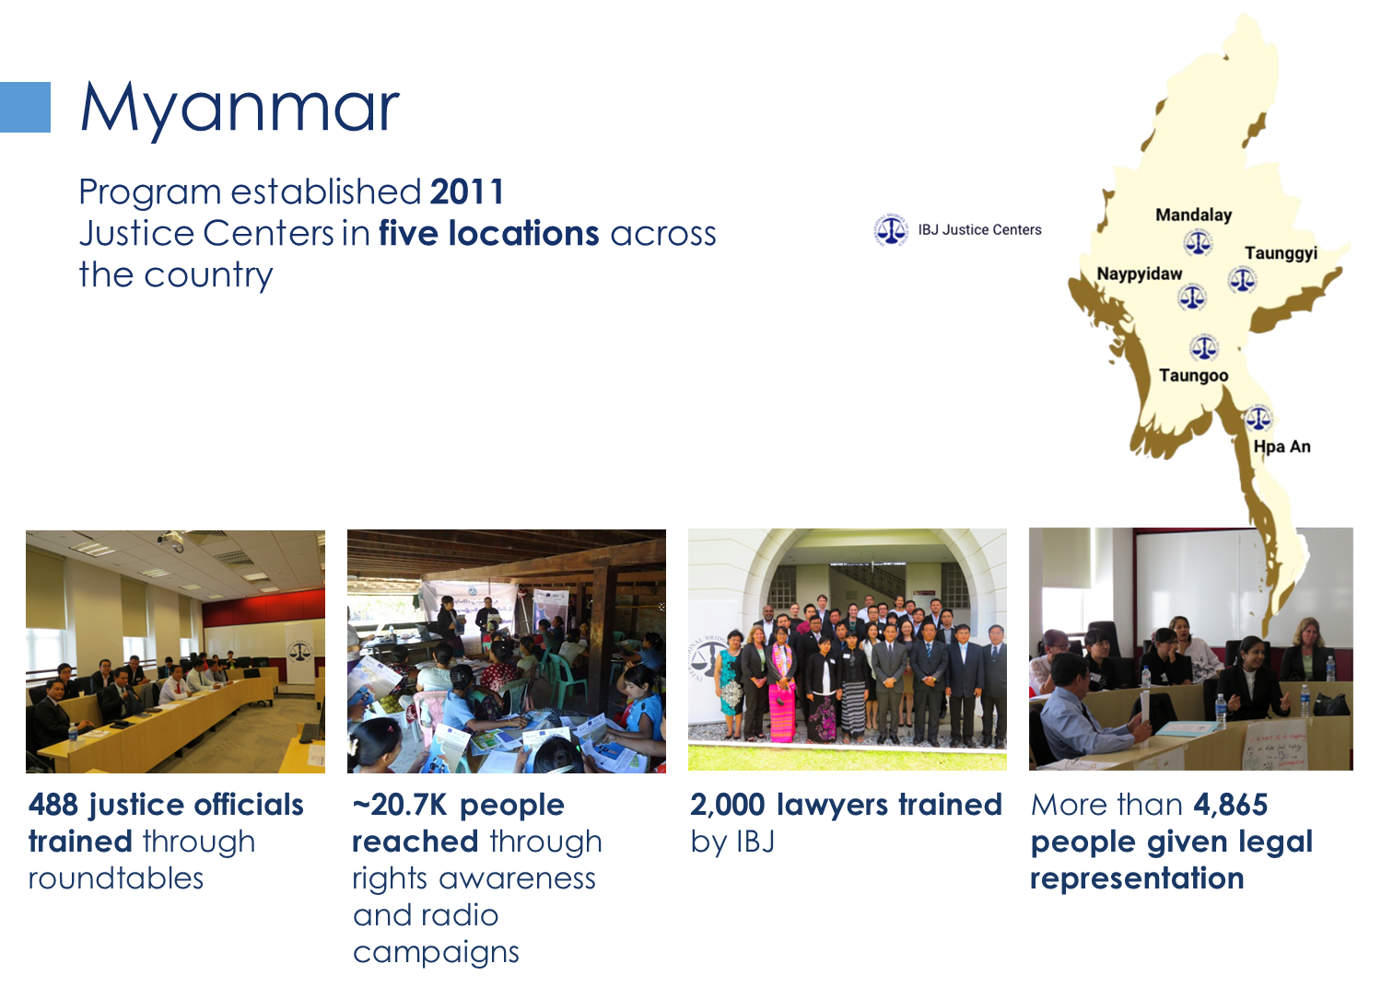



IBJ has 45 local staff members, of which 69% are female, 57% are younger generation, 7% are LGBTQ.
19% of total clients facing criminal charges are women accused.
Of the people seeking for legal help, 59% are women.
35-40% of the criminal cases are politically motivated cases.
Since 2021, IBJ has defended 1300+ politically targeted individuals.
Notes:
65% of IBJ local staff are women, of whom 2 are LGBT
19% of total IBJ clients are women.
40% are prosecuted in criminal law.
25% are in political cases.
20% are in drug cases.
Of the people seeking for legal help, 59% are women.

Slide 3
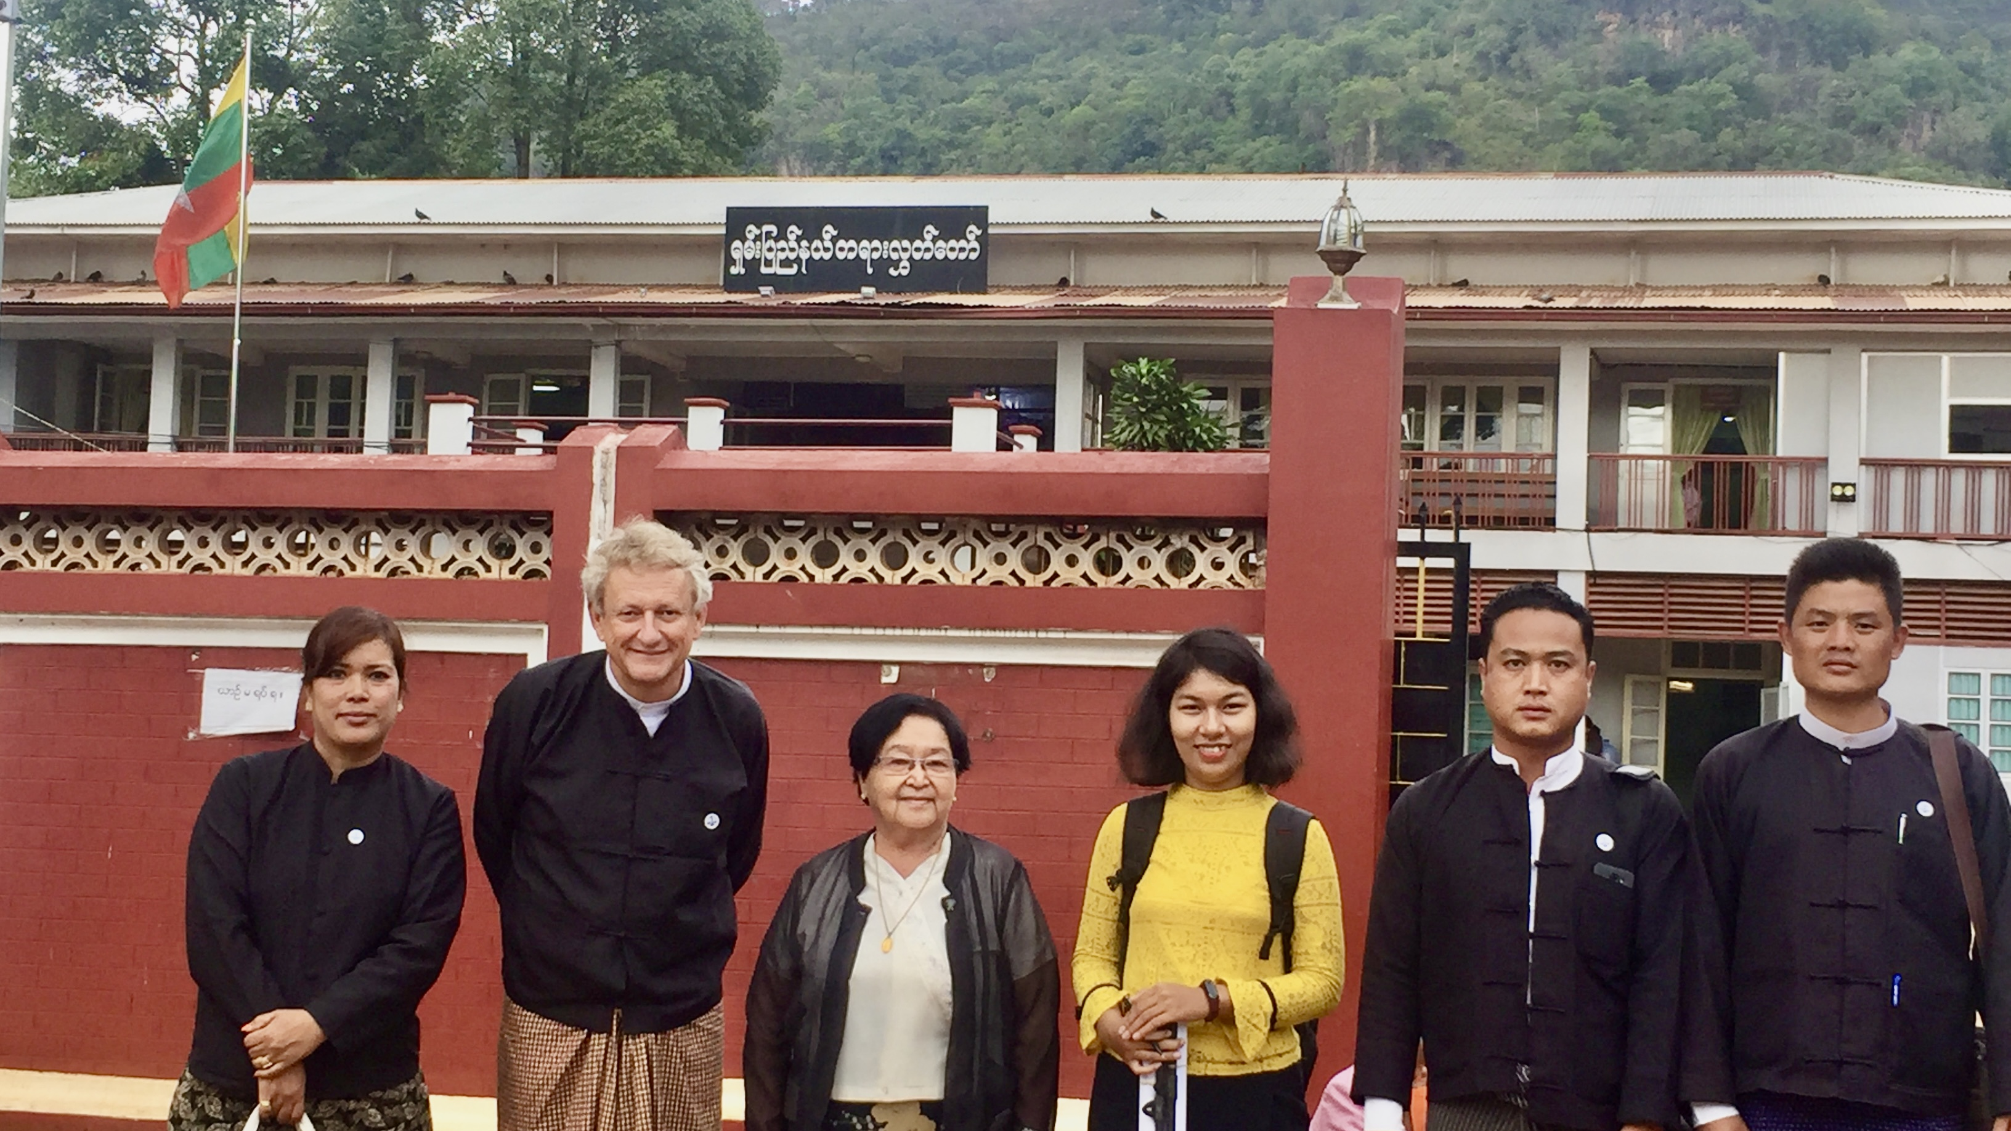
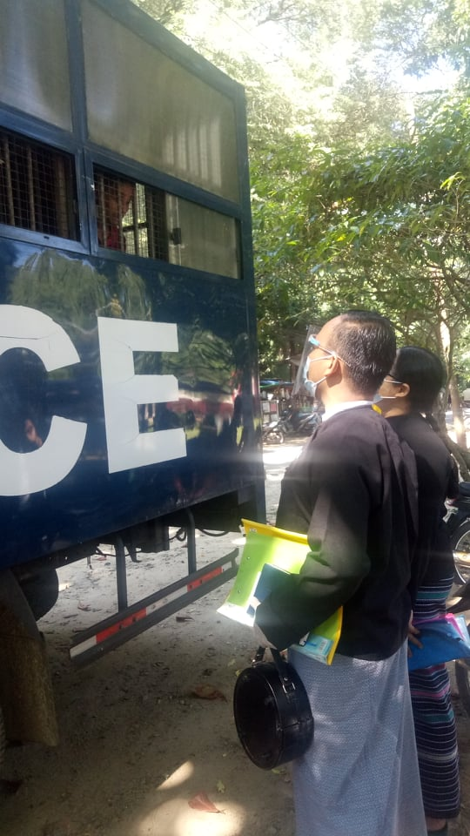
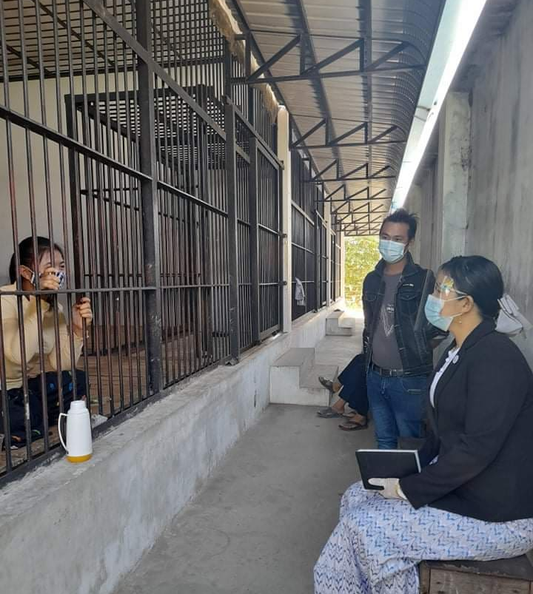
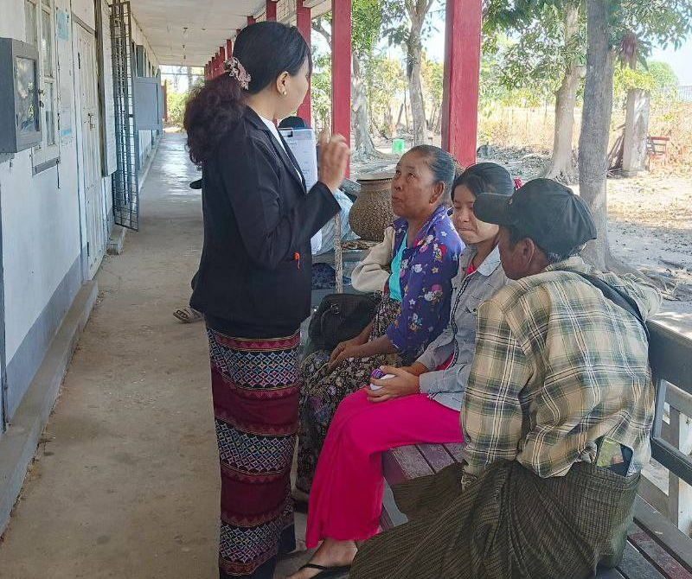
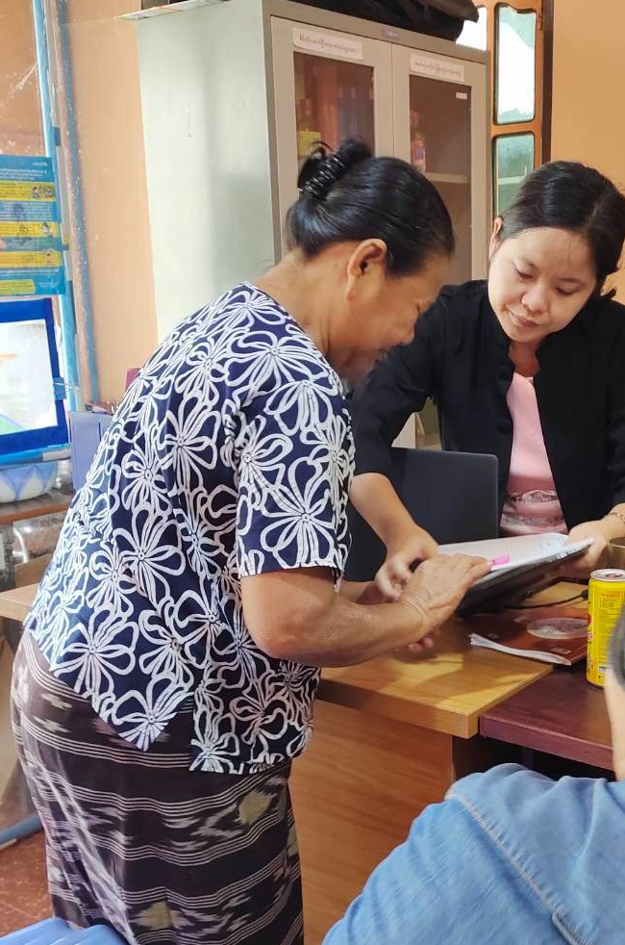
High quality legal representation
Free legal representation -4921 individuals
Legal assistance (Helpline) – 2630 individuals
2000+ Pro Bono Case Referrals
Early intervention
Access to jail, prison
Coordination with other access to justice actors

Slide 4
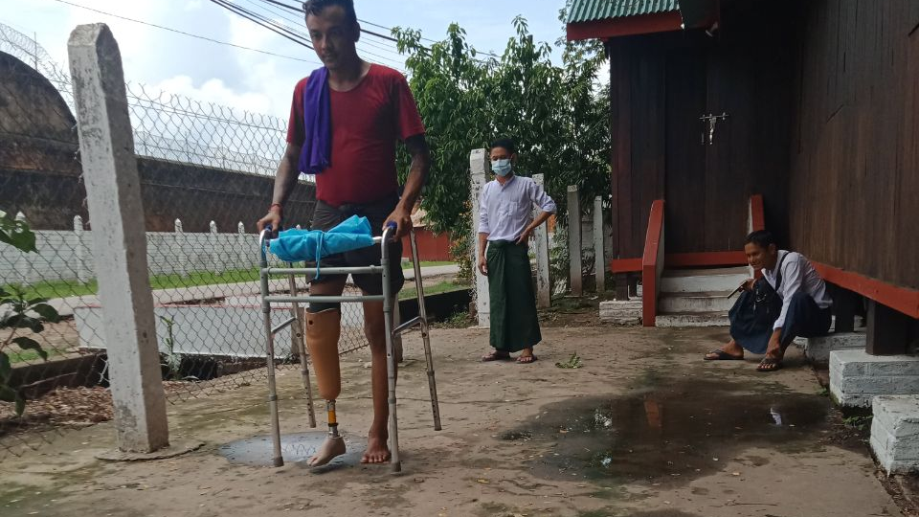
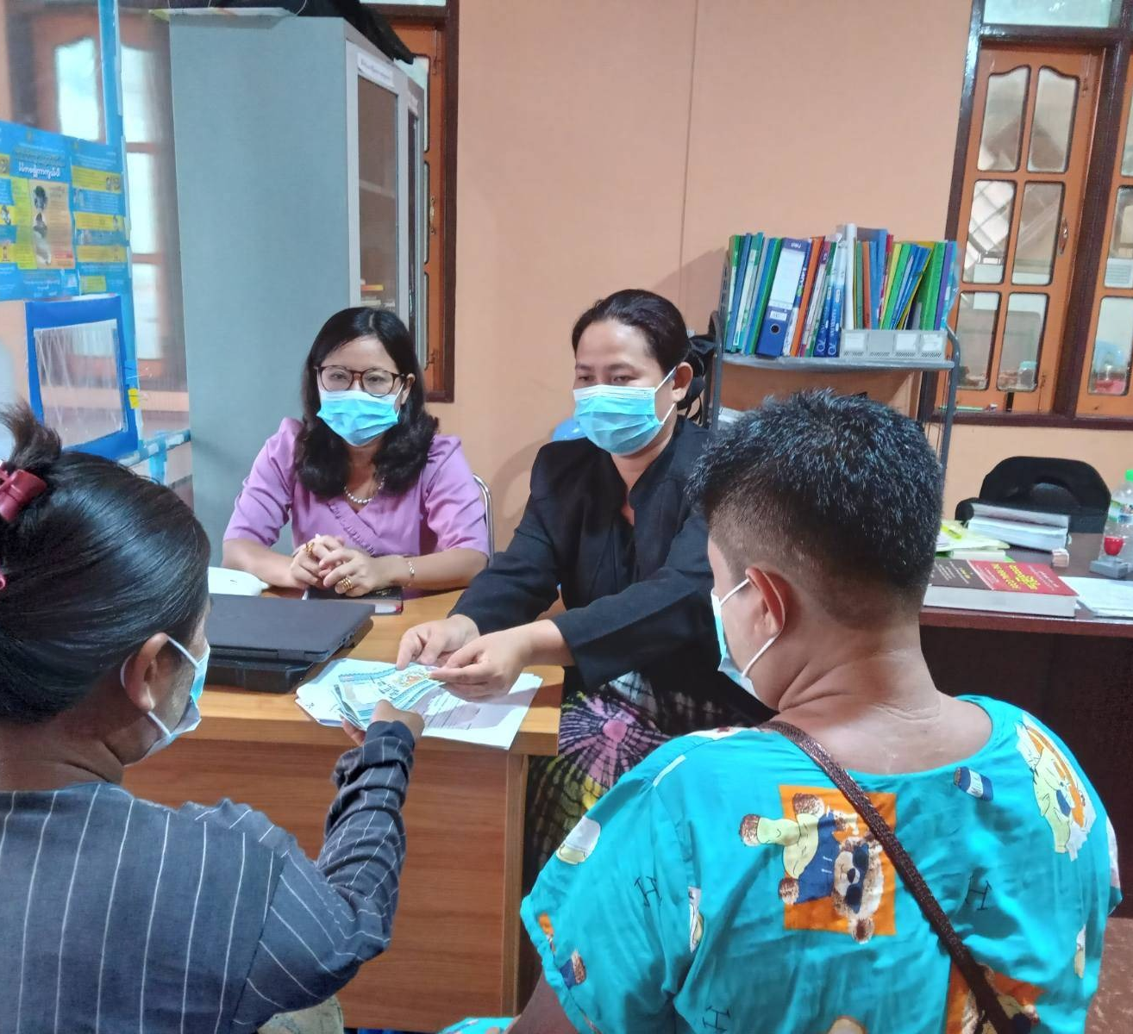
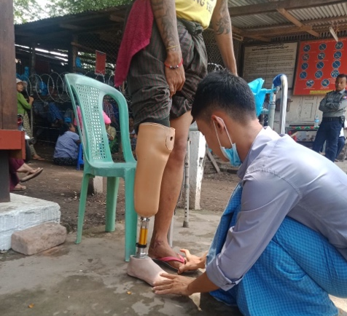
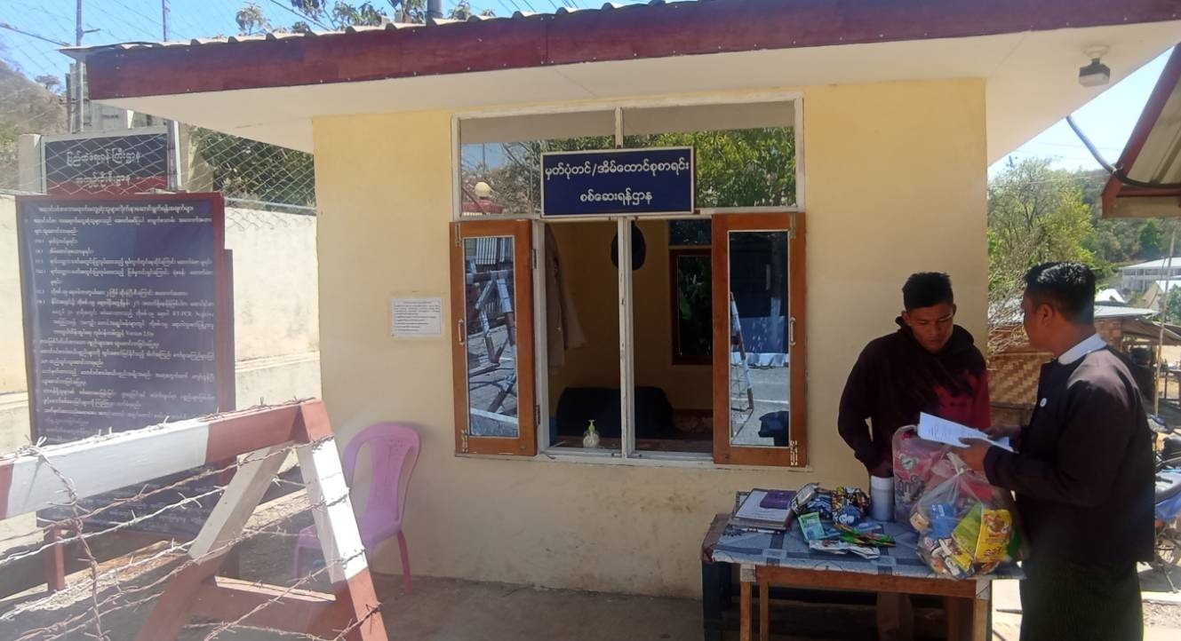
Client-centric Services: Holistic approach
Holistic Referrals to non-legal service providers
Since 2021, IBJ implemented material assistance provision for detainees and prisoners in need, reaching 1200+ individuals.
  Food
  Medicine
  Personal items
  Transportation
  Interpretation
  Safehouse referral

Slide 5
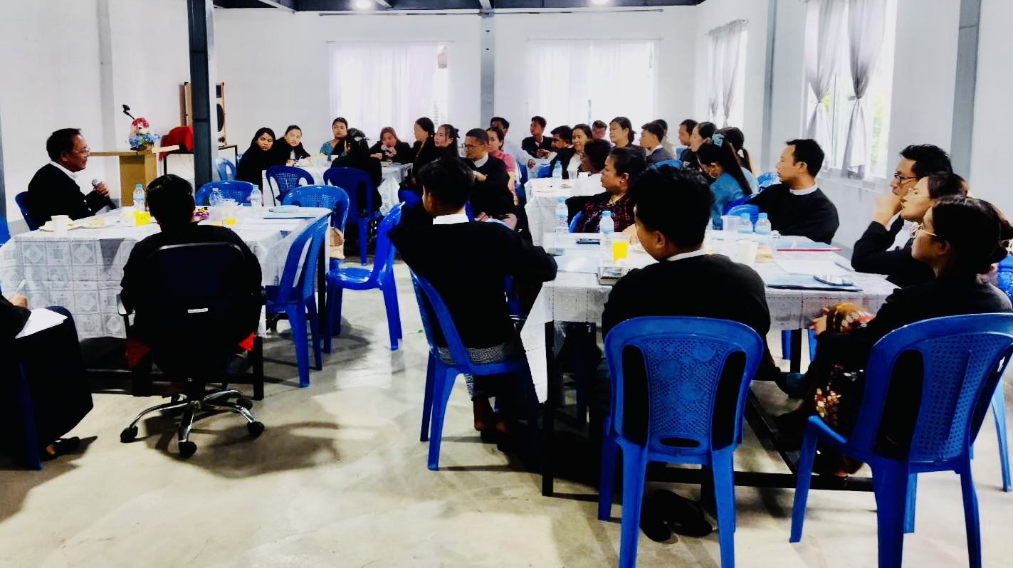
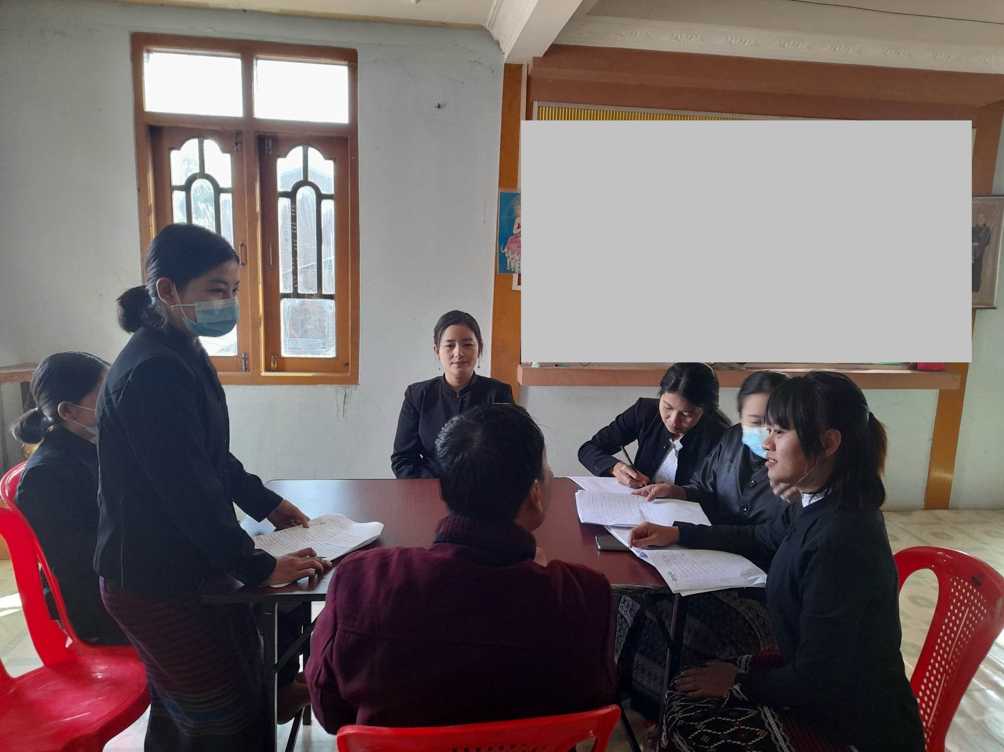
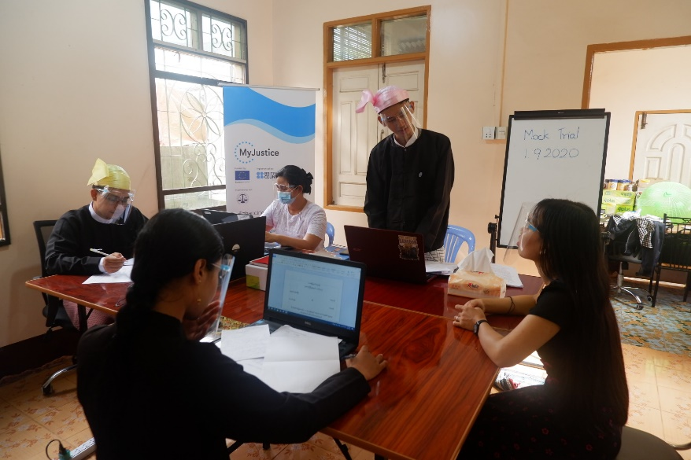
Strengthening legal community of practice
Intensive lawyer trainings reaching 500+ defenders
180+ Pro bono defenders networking and peering learning
Community of Practice (CoP) events
Mentoring and coaching by IBJ’s international legal experts
Internship and apprentice programs reaching 130+ students and young lawyers.

Slide 6
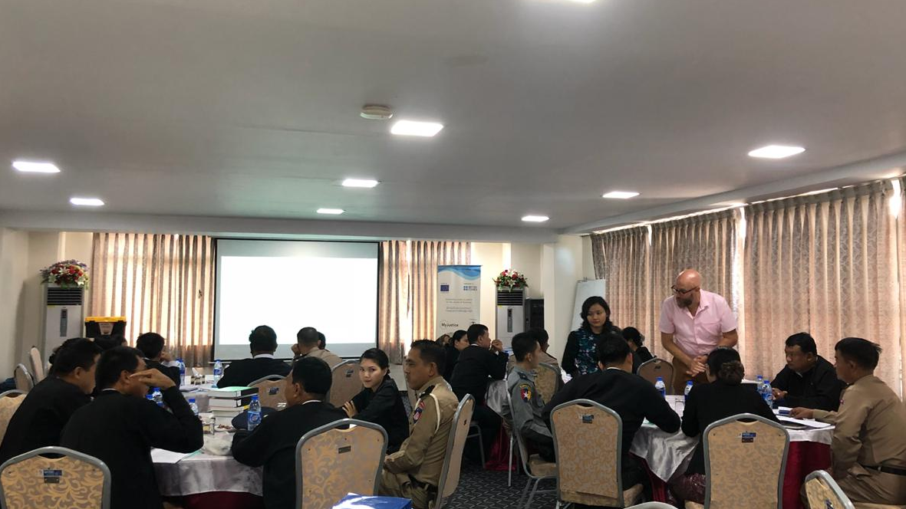
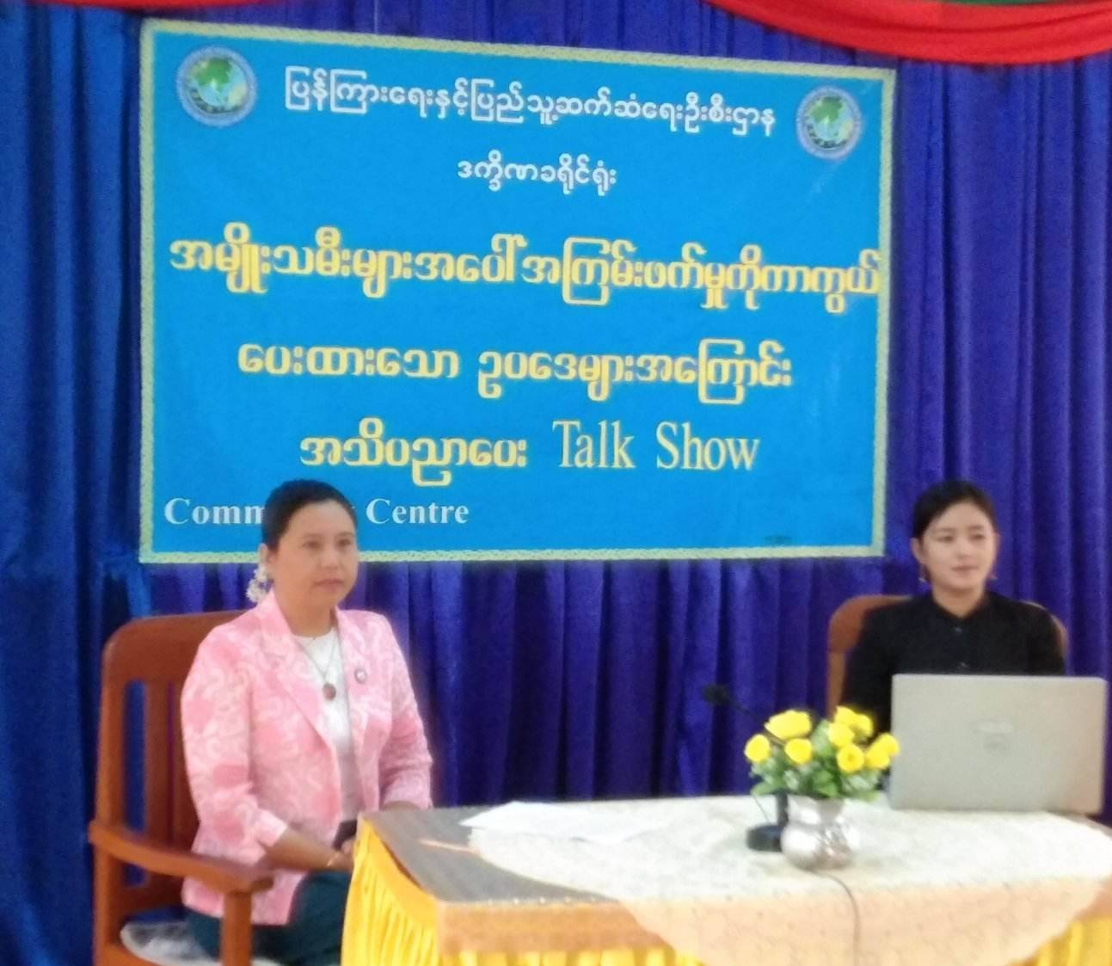
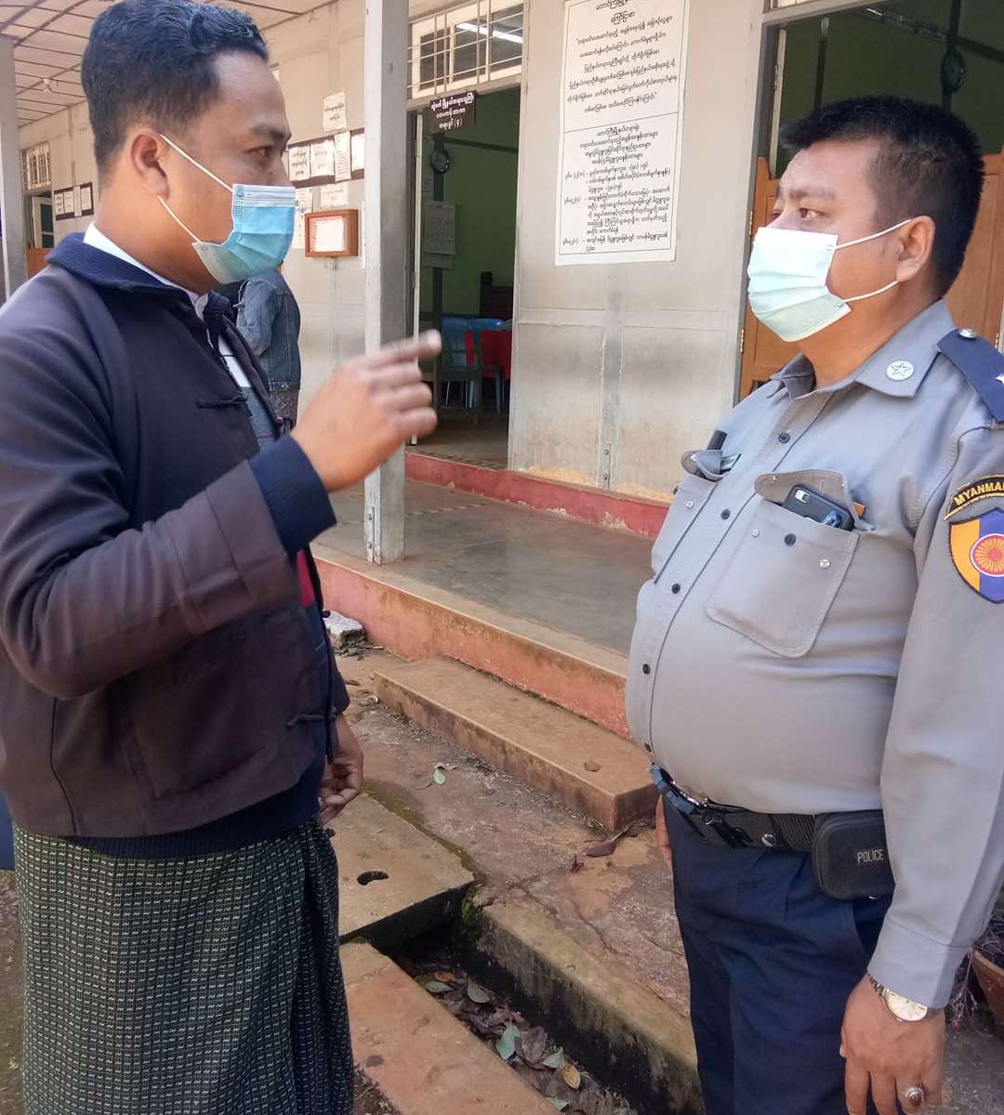
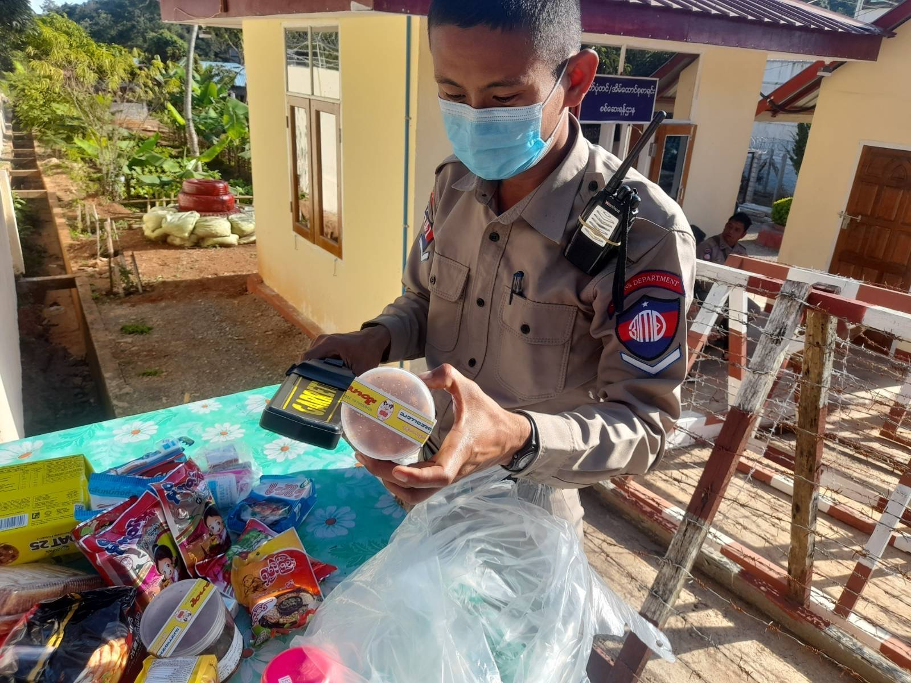
Systemic Change
Strategic Litigation
One-on-one advocacy
Justice-actors Dialogue/ Roundtable
Cooperation with social welfare, government legal aid boards, correction department and relevant authorities
Case referrals from government justice actors

Slide 7
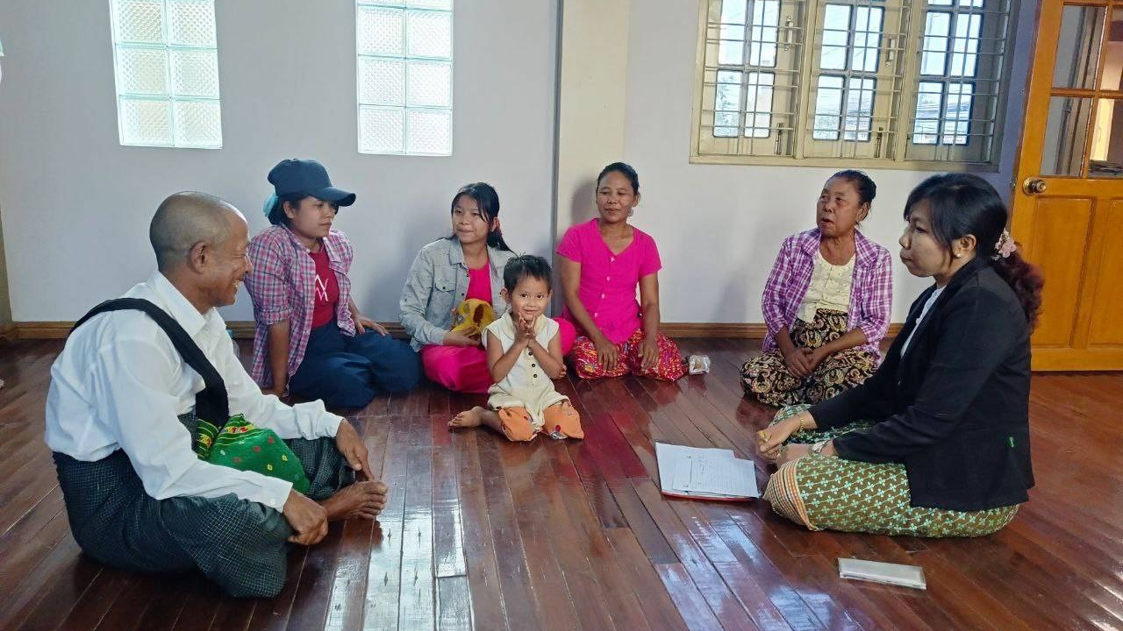
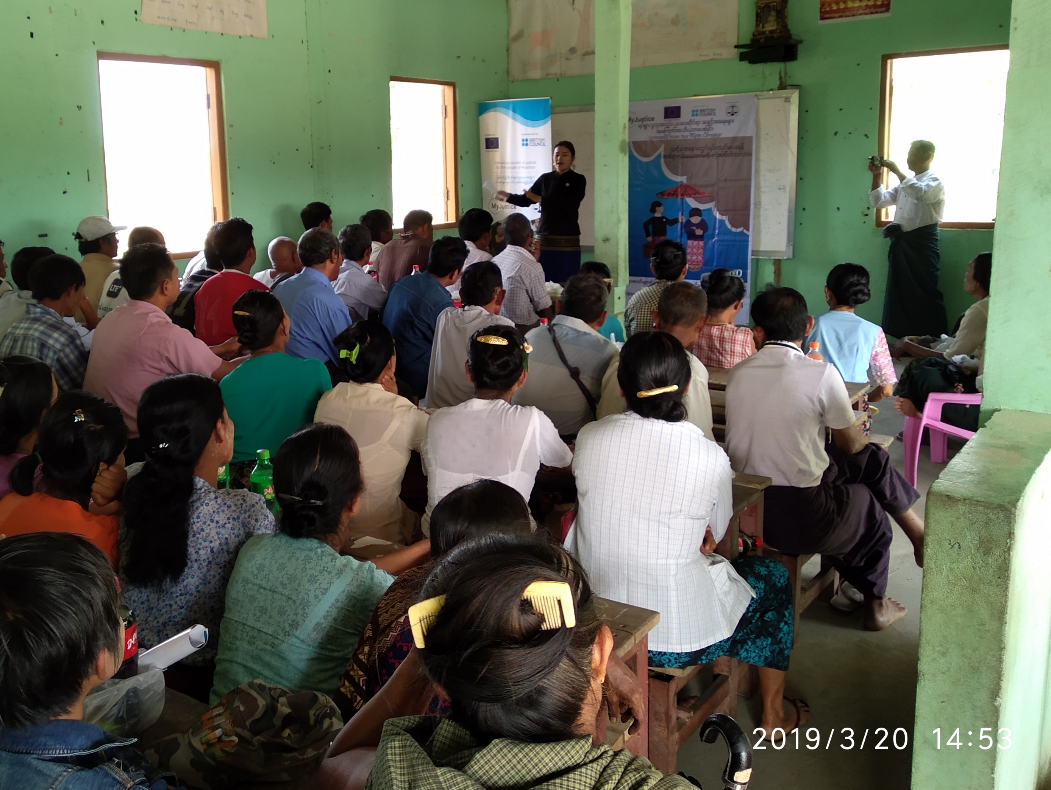
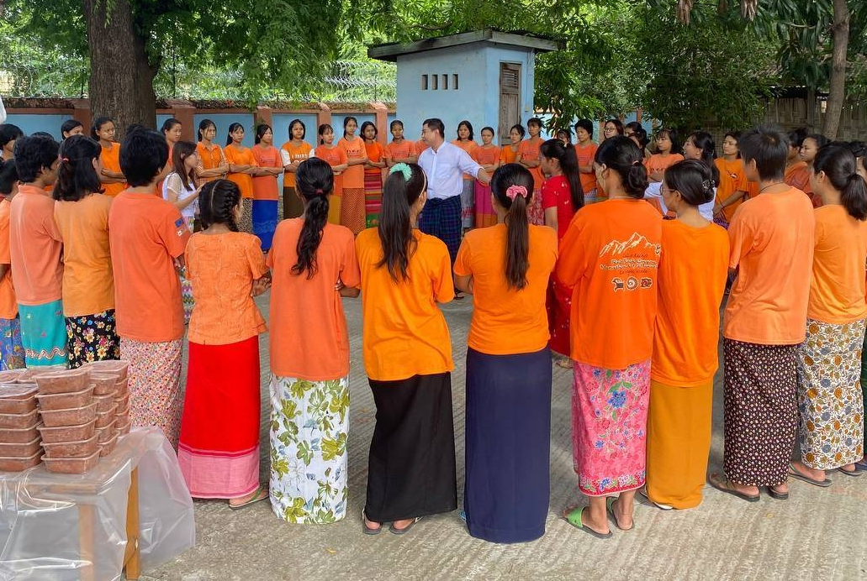
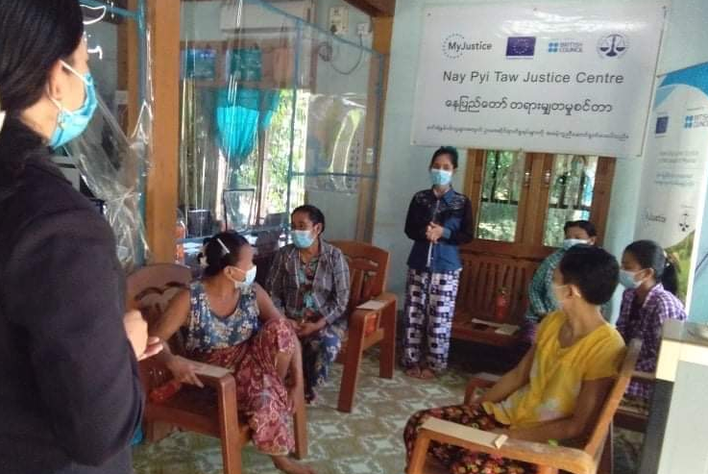
Inclusion and shifting power
Community legal right awareness outreach programs
Focused Group Discussions
Juvenile justice: Detention centers
GESI regular meeting sessions
Legal Advice (Helpline) and referrals

Slide 8
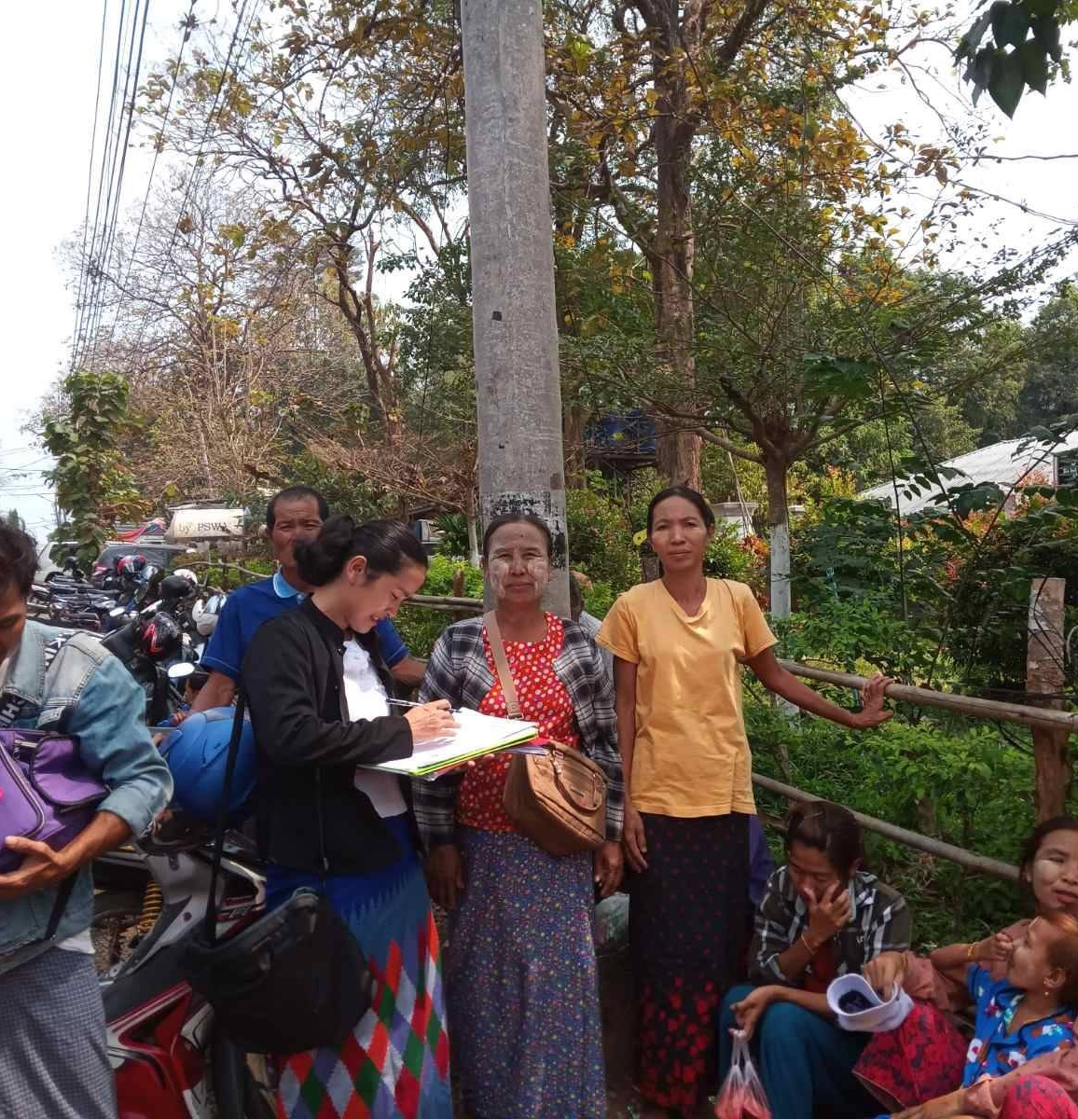
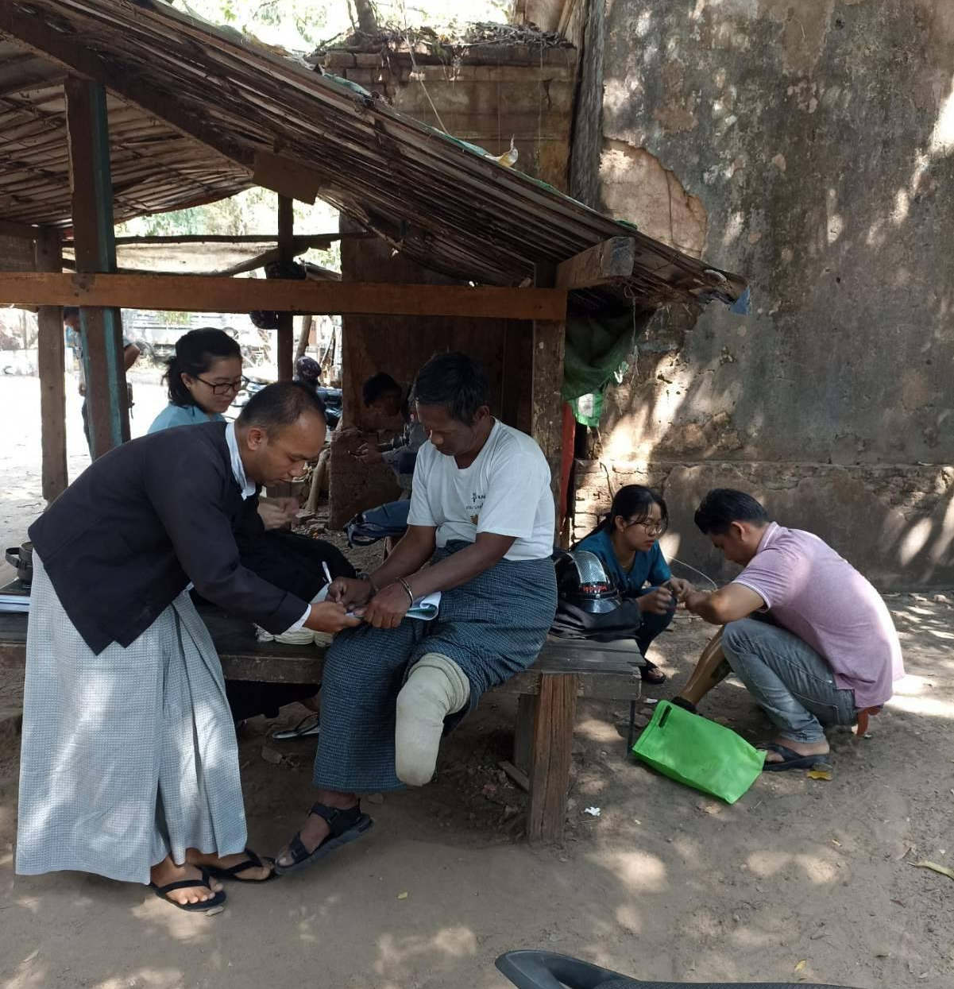
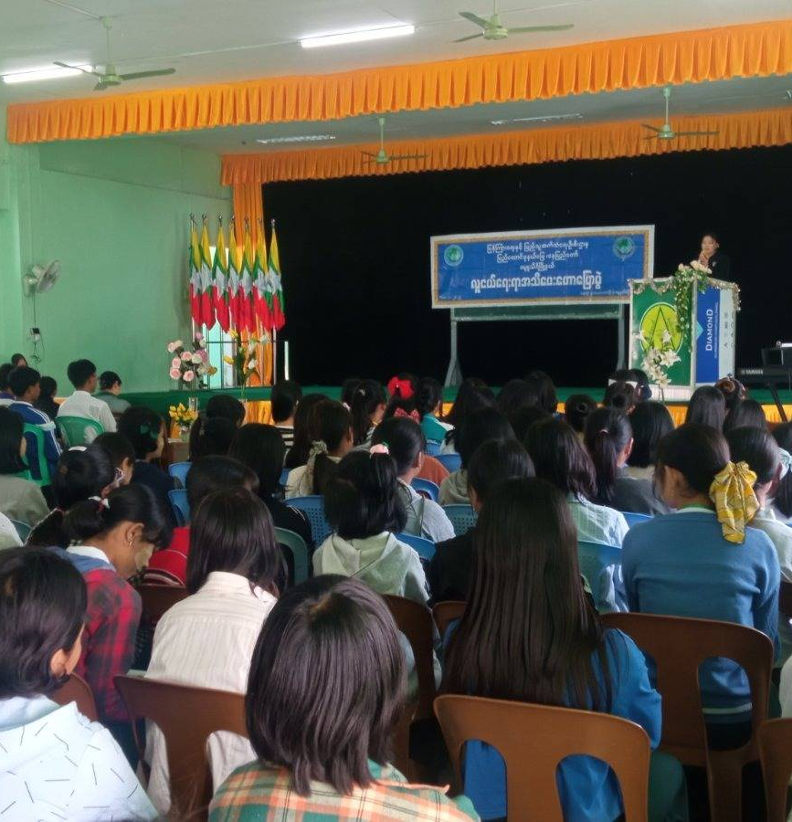
Thank you for your attention…

